Slide 1


IS 669 - Big Data Analytics Project
Sampling and Predicting Delays
Phase - II
Fall 2022
Team Red
Red Team
Prerna Deolekar | Ramya Dhabade | Krina Gandhi Himanshu Hariyani | Shubham Kadam

Slide 2
Team Members & Models:
01
Himanshu Hariyani
Decision Tree
02
Shubham Kadam
Nandu Devarasetty
Deep Learning
03
Ramya Dhabade
Generalized Linear Model
04
Prerna Deolekar
Gradient Boosted Trees
05
Krina Gandhi
Random Forest

Slide 3
Himanshu Hariyani
Decision Tree

Slide 4
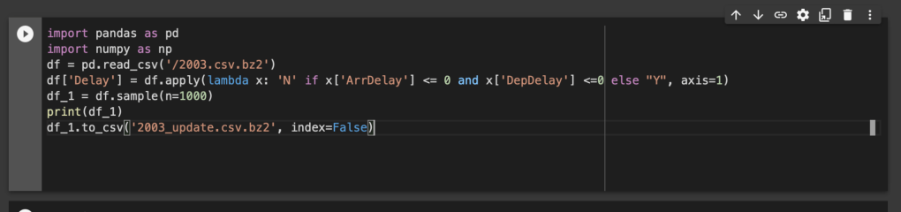
Sampling Of 1000 Records
Himanshu Hariyani

Slide 5
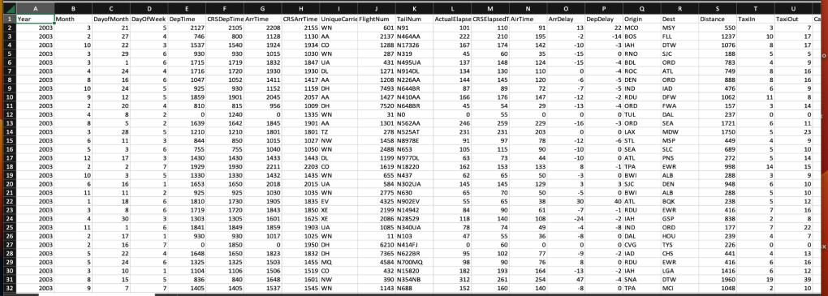
Spreadsheet of 1000 Records
Himanshu Hariyani
Himanshu Hariyani

Slide 6
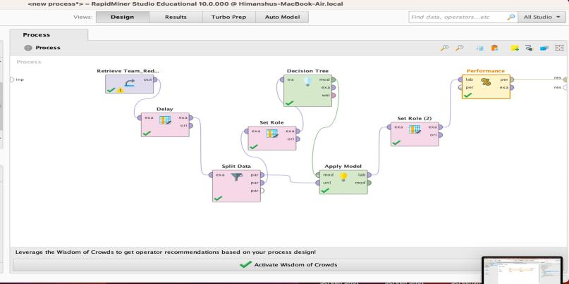
Overall Process
Himanshu Hariyani

Slide 7
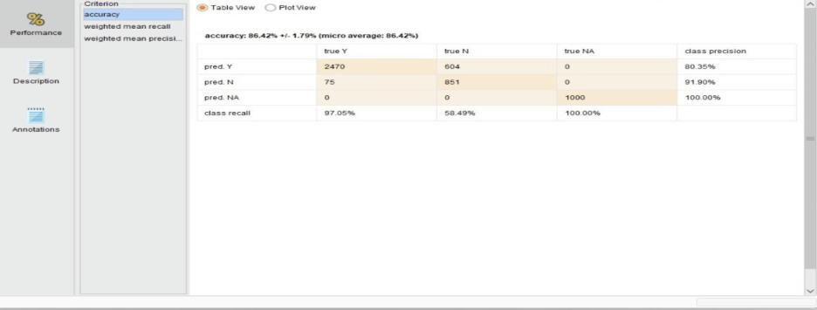
Performance Results
Accuracy-86.42%
Himanshu Hariyani

Slide 8
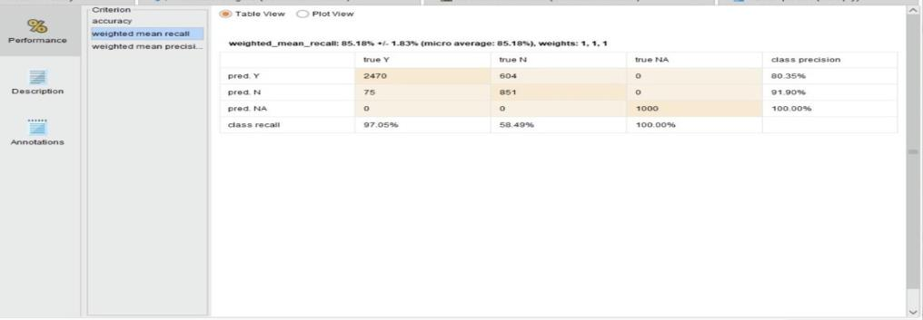
Recall-85.18%
Himanshu Hariyani

Slide 9
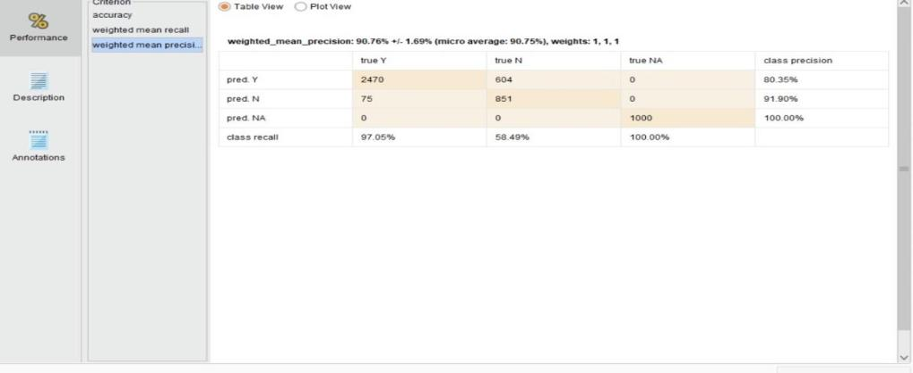
Precision - 90.76%
Himanshu Hariyani

Slide 10
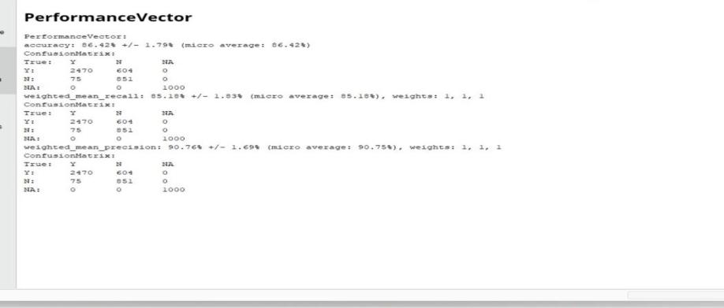
Performance Vector
Himanshu Hariyani

Slide 11
Shubham Kadam
Deep Learning

Slide 12
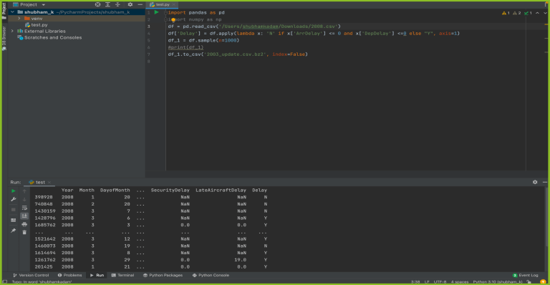
Sampling of 1000 records
Shubham Kadam

Slide 13
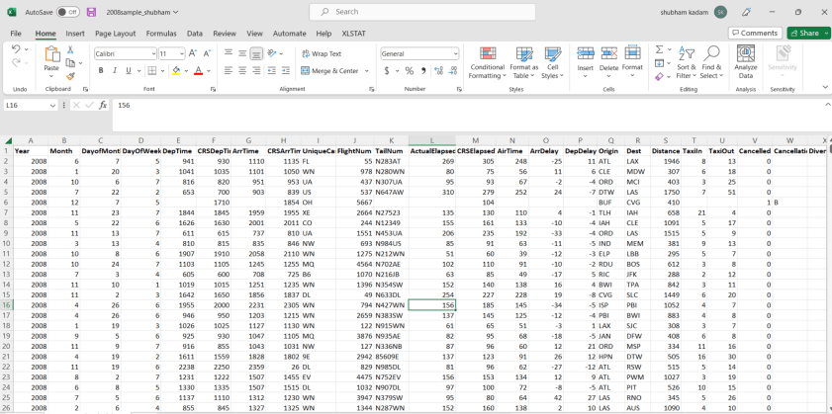
Spreadsheet of 1000 Records
Shubham Kadam

Slide 14
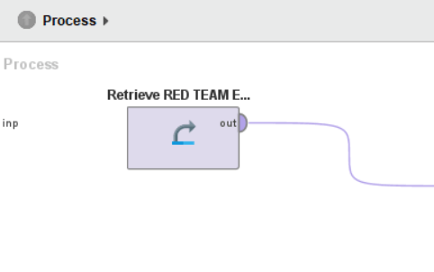
Deep Learning: Data set
We started performing by loading the Flight records dataset into the repository.
Shubham Kadam

Slide 15
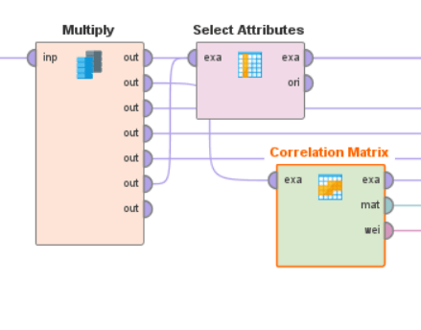
Multiply operator and correlation matrix
The Multiply operator copies what it receives on input to all it's output ports. Using this operator with Filter Examples, you can use one data set to both train and test your model.
The Correlation Matrix Operator determines correlation between all Attributes and it can produce a weights vector based on these correlations.
Shubham Kadam

Slide 16
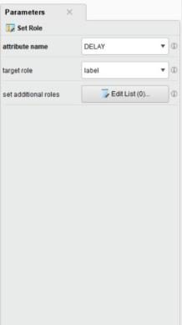
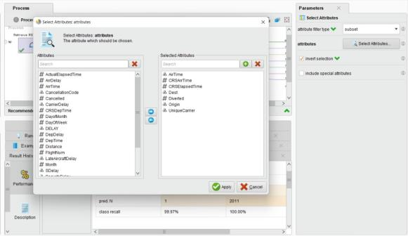
Deep Learning: Set Role and Select attributes
Shubham Kadam

Slide 17
Deep Learning :Cross Validation
It performs a cross validation to estimate the statistical performance of a learning model.
The Cross Validation Operator is a nested Operator. It has two subprocesses: a Training subprocess and a Testing subprocess.
We have added 10 fold in number of fold which means the number of folds (number of subsets) the ExampleSet should be divided into.
Shubham Kadam

Slide 18
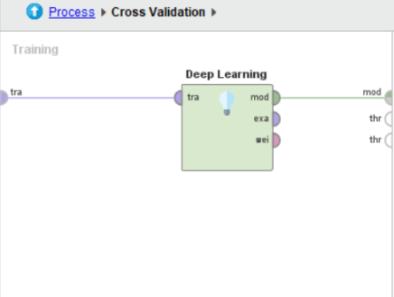
Deep Learning: Model training part
Moved forward with the training data connected to the Deep Learning model .
Here we have changed to the suitable values for epochs, activation and for
Hidden layers and train sample per iteration for getting appropriate result of this model.
Shubham Kadam

Slide 19
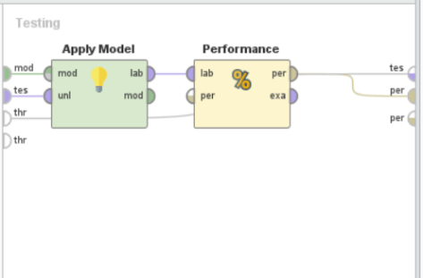
Deep Learning: Model Testing part
We linked the model to the apply model after processing the data into it.
Another Operator, which is frequently a learning algorithm, first trains a model on an ExampleSet.
This model can then be applied to another ExampleSet.
Typically, the purpose is to make a forecast based on previously unknown data or to alter data using a preprocessing model.
After connecting to the Performance operator, we employed the performance classification in which we applied our key criterion, accuracy, weighted mean recall, and weighted mean precision. Finally, it is linked to the performance node.
Shubham Kadam

Slide 20
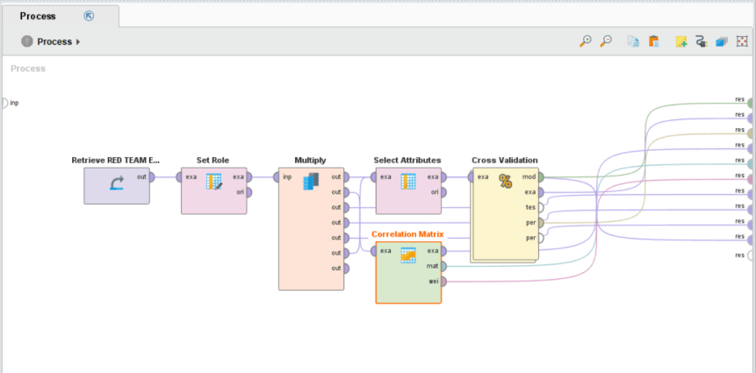
Overall Process
Shubham Kadam

Slide 21
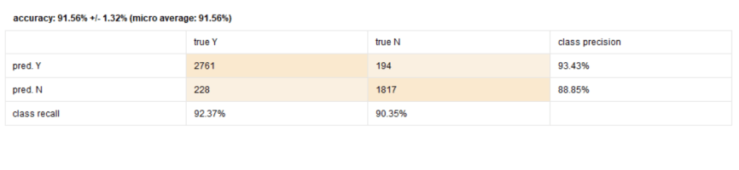
Performance results
1- Accuracy - 91.56 %
Shubham Kadam

Slide 22
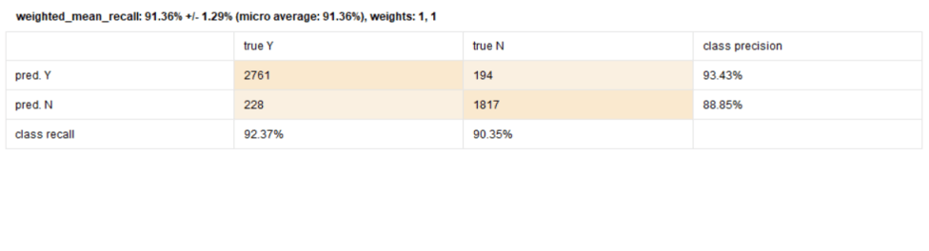
2- Recall - 91.36 %
Shubham Kadam

Slide 23
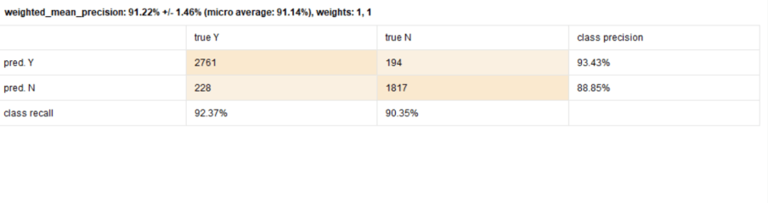
3- Precision - 91.22 %
Shubham Kadam

Slide 24
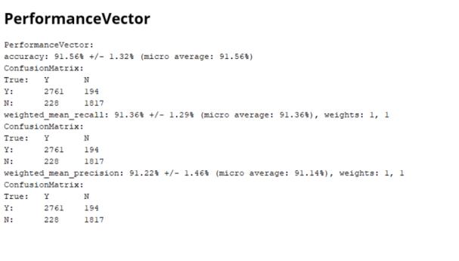
Performance Vector
Shubham Kadam

Slide 25
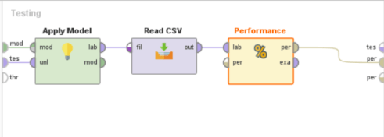
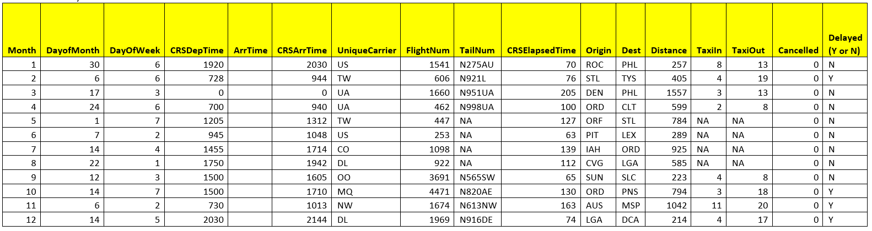
Deep Learning - Predicting Unknown Records
Used Read CSV File for prediction of 12 unknown records
Krina Gandhi

Slide 26
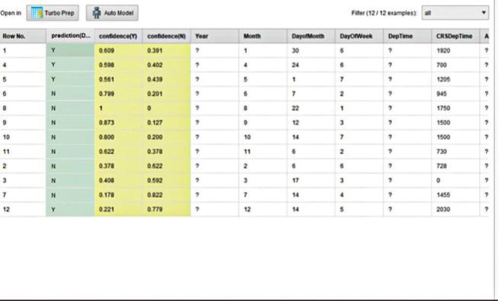
Data model - Deep Learning
The ratio which I received was 4:8 i.e 4 Delay and 8 No Delay
Prerna Deolekar

Slide 27


Generalized Linear Model
Ramya Dhabade - Year 1993

Slide 28
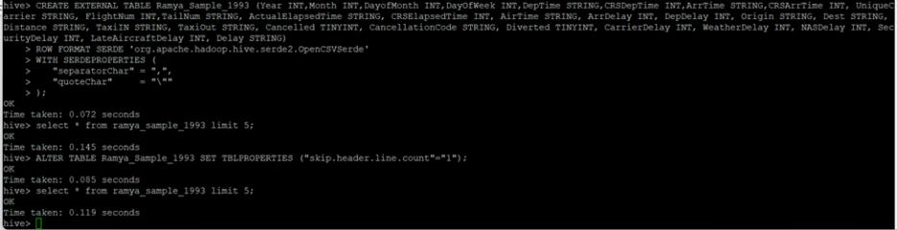
Created table Ramya_Sample_1993 to insert the sample records & added the column Delay.
Ramya Dhabade - Year 1993

Slide 29
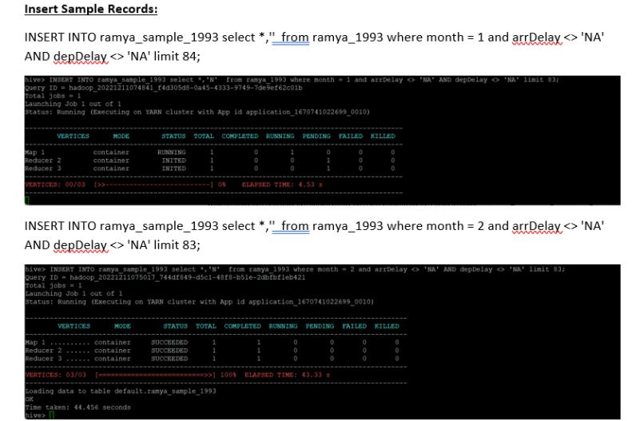
Ramya Dhabade - Year 1993

Slide 30
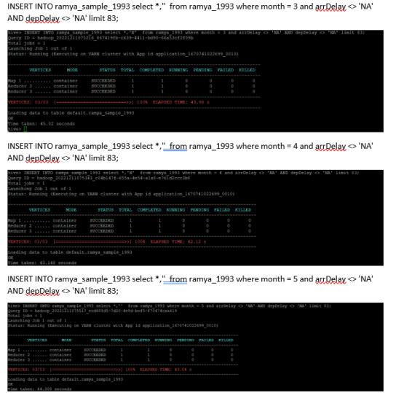
Ramya Dhabade - Year 1993

Slide 31
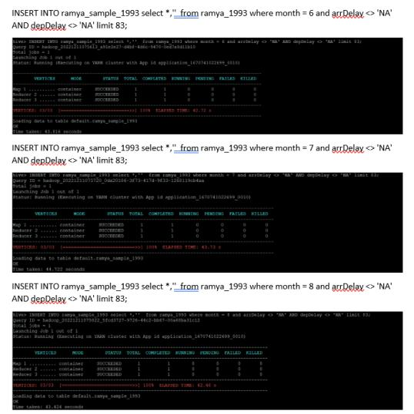
Ramya Dhabade - Year 1993

Slide 32
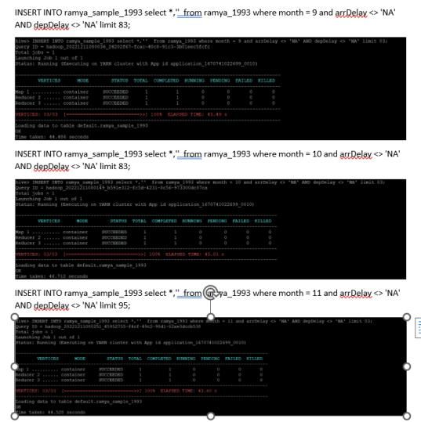
Ramya Dhabade - Year 1993

Slide 33
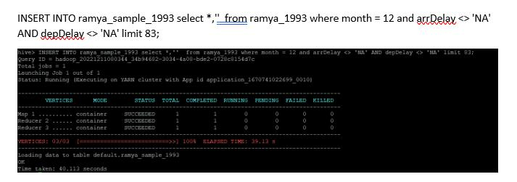
Ramya Dhabade - Year 1993

Slide 34
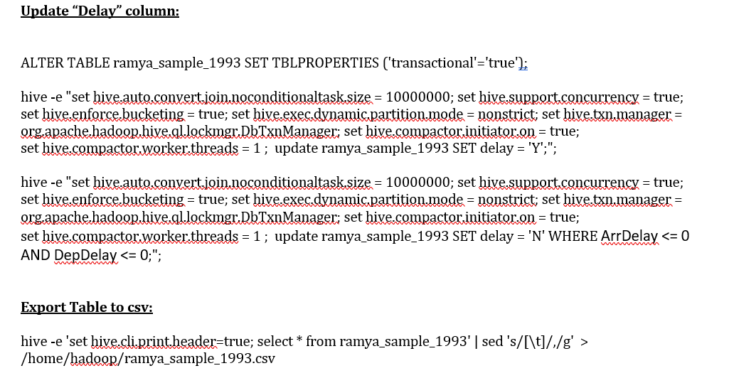
Populated the Delay column as follows a. if the record has a value of zero or less in the ArrDelay and DepDelay columns, put a “N” in the Delay column b. otherwise, put a “Y” in the Delay column
Ramya Dhabade - Year 1993

Slide 35
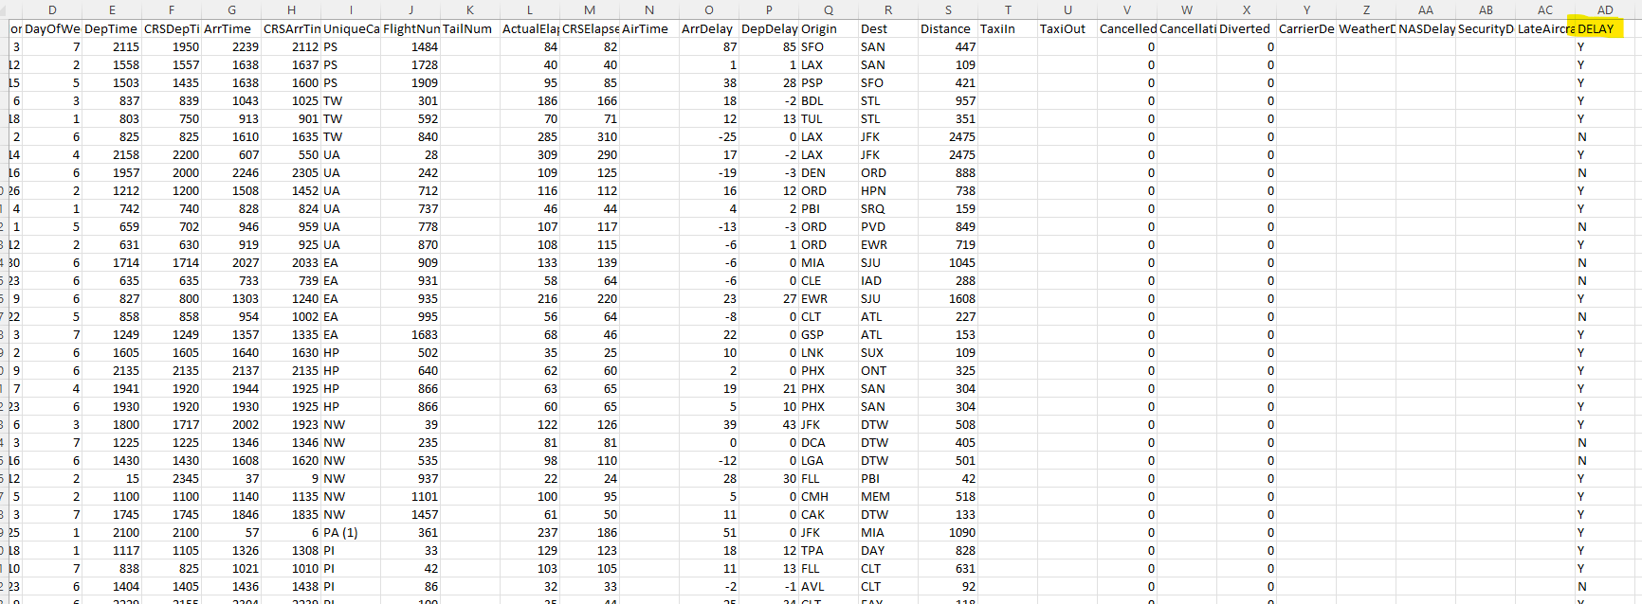
Delay Column
Ramya Dhabade - Year 1993

Slide 36
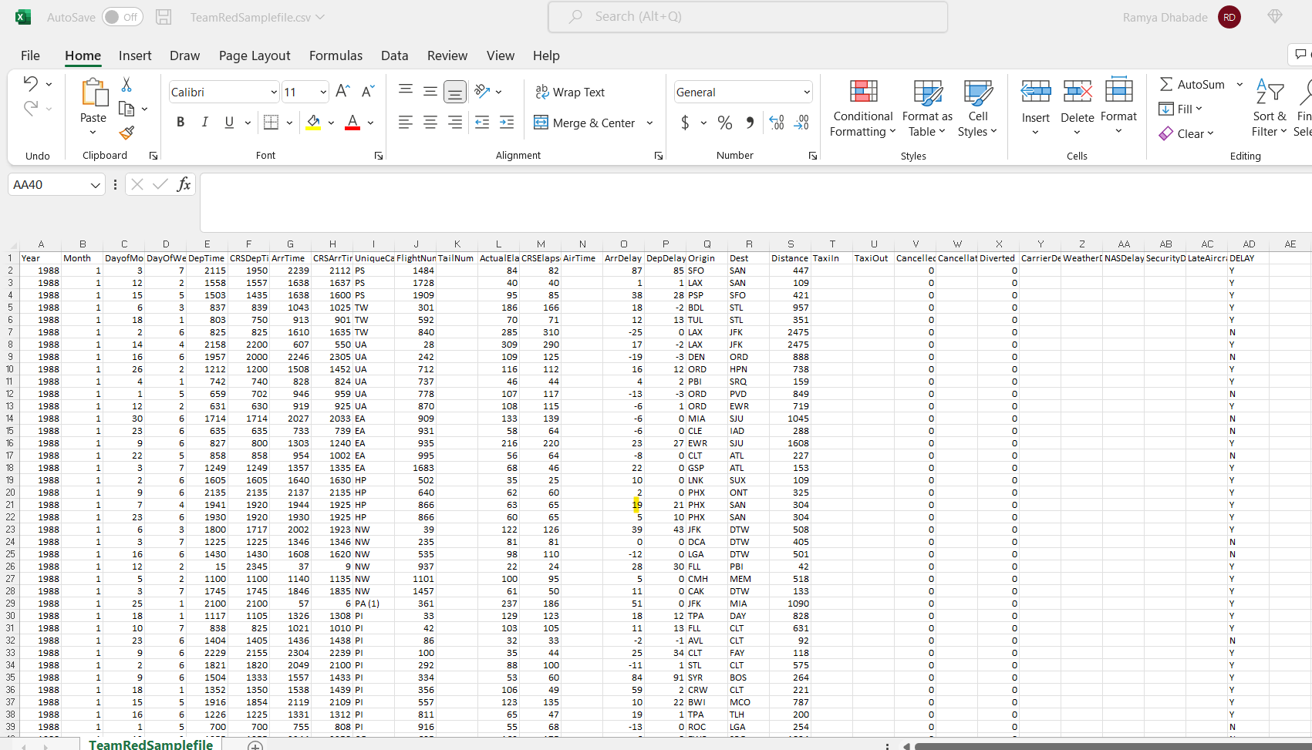
TeamRedSamplefile.csv : Combined Data Snapshot - 5000 rows
Ramya Dhabade - Year 1993

Slide 37
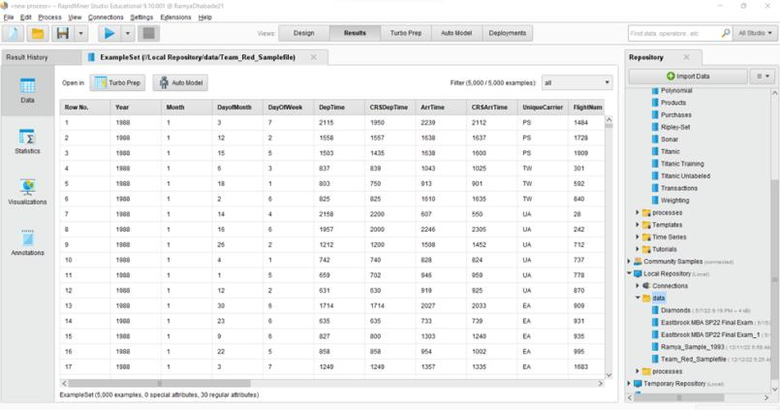
Combined .csv file of all group members & imported data into Rapidminer for analysis.
Ramya Dhabade - Year 1993

Slide 38
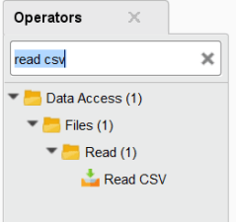
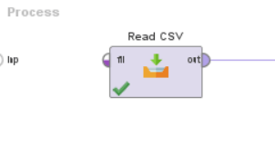
Data model – Generalized Linear Model
Generalized Linear Model (GLM) - An advanced statistical modelling technique, an umbrella term that encompasses many other models and, which allows the response variable Y (dependent) to have an error distribution other than a normal distribution i.e. it allows residuals to have other distributions from the exponential family of distributions.
Step 1: Read CSV file.
Ramya Dhabade - Year 1993

Slide 39
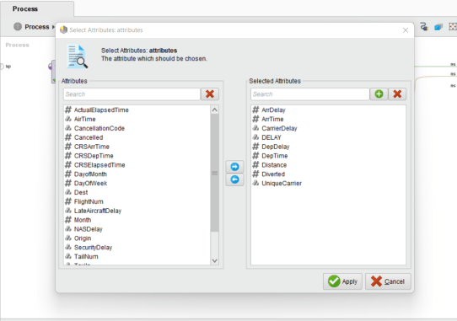
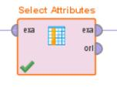
Data model – Generalized Linear Model
GLM models allow us to build a linear relationship between the response and predictors, even though their underlying relationship is not linear. The GLM operator is used to predict the Future customer attribute of the Deals sample data set
Step 2: Add Select Attributes
Ramya Dhabade - Year 1993

Slide 40
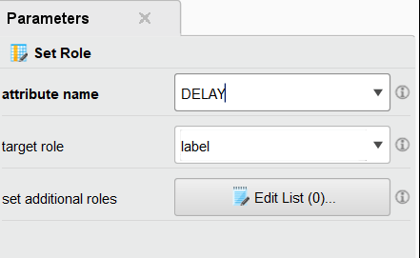
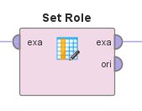
Data model – Generalized Linear Model
Step 3: Add “Set Role”. It is used to change the role of one or more Attributes.
First, the Data was extracted and retrieved and then imported from the Repository then, at that point, we associate it to set role to indicate the job for the extraordinary attribute "attrition flag" which it "Label" target role.
Ramya Dhabade - Year 1993

Slide 41
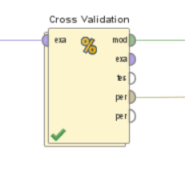
Data model – Generalized Linear Model
Step 4: Add “Cross Validation”.
The Cross Validation Operator was used. It performs cross-validation to assess the factual performance of a learning model.
Ramya Dhabade - Year 1993

Slide 42
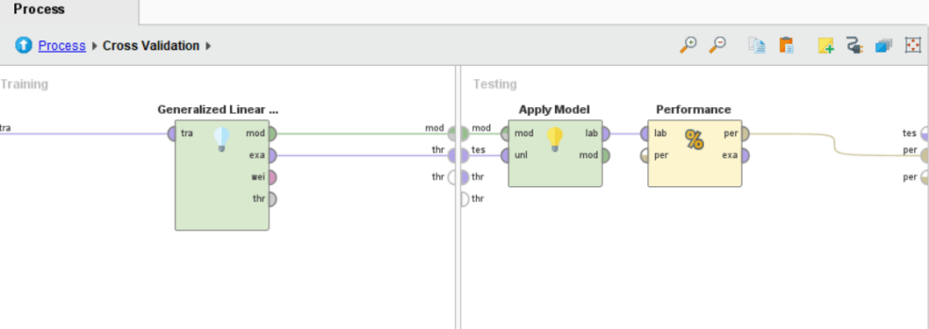
How the process works inside Cross validation?
Generalized linear model is used for training purpose. While for testing the handling the information into model we associated model to the apply model. A model is first prepared on an ExampleSet by another Operator, which is much of the time a learning calculation.handling the information into model we associated model to the apply model.
Ramya Dhabade - Year 1993

Slide 43
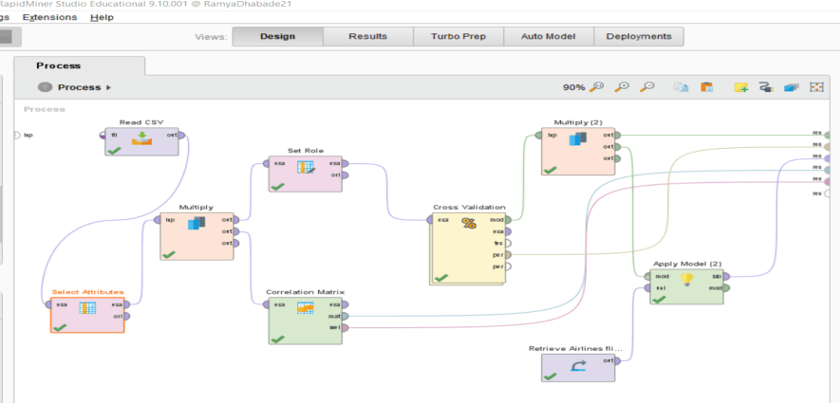
Data model – Generalized Linear Model
Unlabelled flights data is read and modelled using Generalized Linear Model
Ramya Dhabade - Year 1993

Slide 44
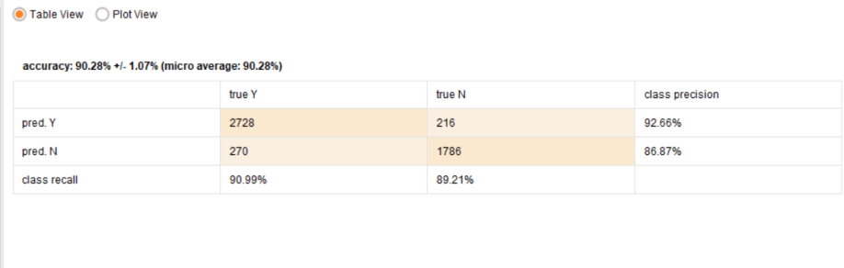
Results: Accuracy
Subsequent to interfacing with apply model named information shared to the Performance operator.
Here we have involved the presentation characterization in which we have applied our primary basis on accuracy, weighted mean recall, weighted mean precision. In conclusion it's associated with the performance hub/node.
Ramya Dhabade - Year 1993

Slide 45
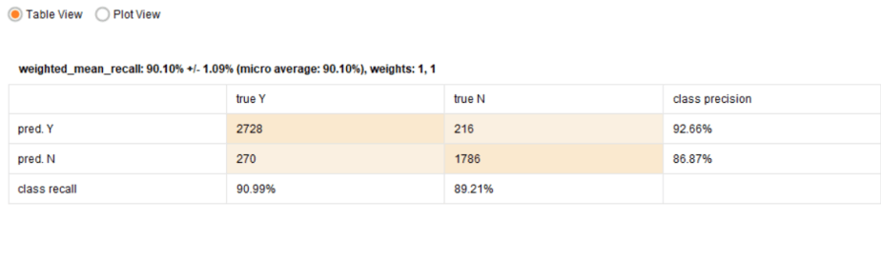
Results: Weighted mean recall
Ramya Dhabade - Year 1993

Slide 46
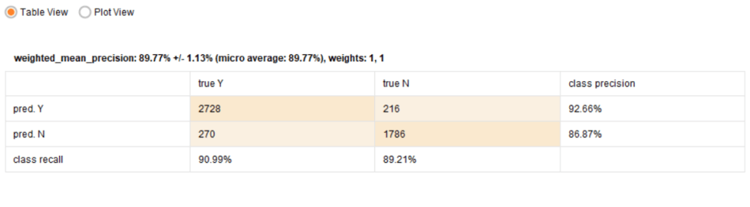
Results: Weighted mean precision
Ramya Dhabade - Year 1993

Slide 47
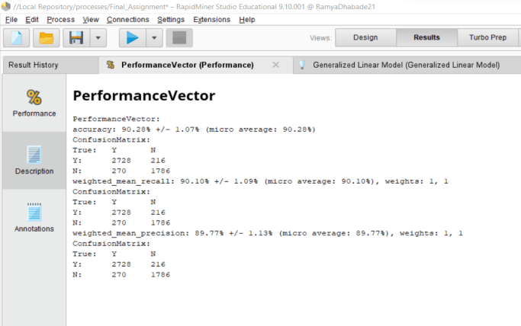
Results : Performance Vector Description
Ramya Dhabade - Year 1993

Slide 48
Prerna Deolekar
Gradient Boosted Trees

Slide 49
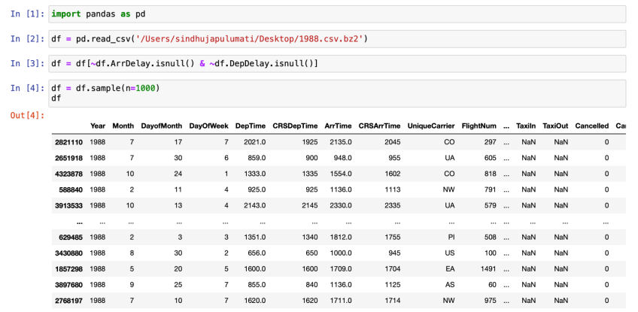
Sampling 1000 records from .csv file in python
Prerna Deolekar

Slide 50
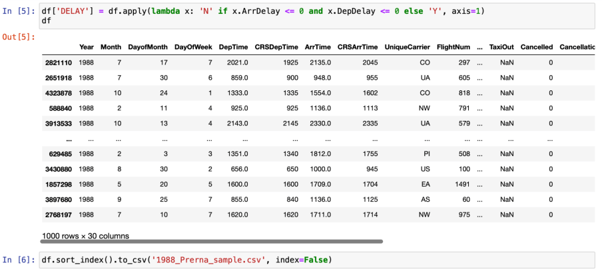
Prerna Deolekar

Slide 51
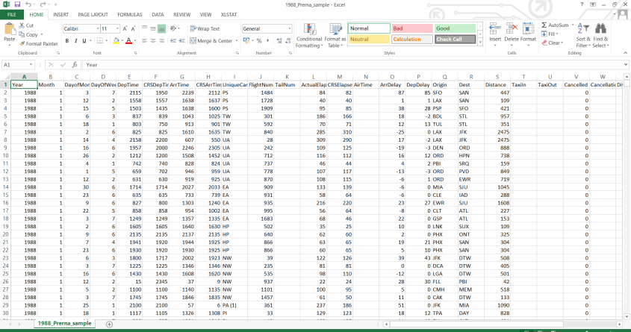
Sampling 1000 records from .csv file
Prerna Deolekar

Slide 52
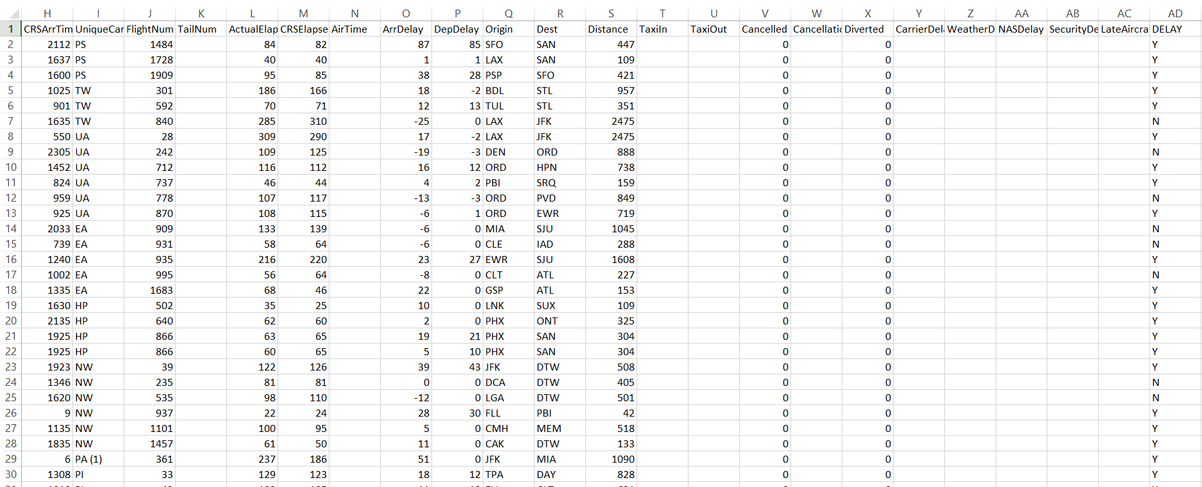
Sampling 1000 records from .csv file
If ArrDelay and DepDelay value <= 0, N is displayed in Delay column, otherwise Y
Prerna Deolekar

Slide 53

Combined .csv file of all group members
In total we have a dataset of 5000 rows
Prerna Deolekar

Slide 54

Data model - Gradient Boosted Tree
A gradient boosted model is an ensemble of either regression or classification tree models. Both are forward-learning ensemble methods that obtain predictive results through gradually improved estimations. Boosting is a flexible nonlinear regression procedure that helps improving the accuracy of trees. By sequentially applying weak classification algorithms to the incrementally changed data, a series of decision trees are created that produce an ensemble of weak prediction models.
Prerna Deolekar

Slide 55


Data model - Gradient Boosted Tree
Used Rapidminer for data modelling
Prerna Deolekar

Slide 56

Data model - Gradient Boosted Tree
Step 1:
This Operator reads data from the specified CSV file.
Prerna Deolekar

Slide 57


Data model - Gradient Boosted Tree
Step 2:
This Operator selects a subset of Attributes of the dataset and removes the other Attributes. Only the selected Attributes are delivered to the output port.
Prerna Deolekar

Slide 58
Data model - Gradient Boosted Tree
Step 3:
This Operator is used to change the role of one or more Attributes. The role of an Attribute describes how other Operators handle this Attribute.
Attribute name can be selected from the dropdown menu. An Attribute with the label role acts as a target Attribute for learning Operators.
Prerna Deolekar

Slide 59

Data model - Gradient Boosted Tree
Step 4:
This Operator performs a cross validation to estimate the statistical performance of a learning model. The Cross Validation Operator is a nested Operator. It has two subprocesses: a Training subprocess and a Testing subprocess. The Training subprocess is used for training a model. The trained model is then applied in the Testing subprocess. The performance of the model is measured during the Testing phase.
Prerna Deolekar

Slide 60

Data model - Gradient Boosted Tree
Accuracy - 99.94
Prerna Deolekar

Slide 61

Data model - Gradient Boosted Tree
Recall- 99.94
Prerna Deolekar

Slide 62

Data model - Gradient Boosted Tree
Precision - 99.93
Prerna Deolekar

Slide 63

Data model - Gradient Boosted Tree
Summary of Accuracy, Recall and Precision parameters
Prerna Deolekar

Slide 64

Data model - Gradient Boosted Tree
Unlabelled flights data is read and modelled using Gradient Boosted Tree
Prerna Deolekar

Slide 65

Data model - Gradient Boosted Tree
Selection of Attributes
Prerna Deolekar

Slide 66

Data model - Gradient Boosted Tree
The ratio i got is 4:8 i.e 4 Delay and 8 No Delay
Prerna Deolekar

Slide 67
Krina Gandhi
Random Forest
Krina Gandhi

Slide 68

Sampling the Data:
Krina Gandhi

Slide 69


Sampling the Data:
Krina Gandhi

Slide 70


Sampling the Data:
Krina Gandhi

Slide 71

Sampling the Data:
Krina Gandhi

Slide 72


Sampling the Data:
After saving sample as csv, combined all the team member’s years sample file in excel
Krina Gandhi

Slide 73

Combined Data:
Krina Gandhi

Slide 74



Exploratory Data Analysis:
Krina Gandhi

Slide 75

Exploratory Data Analysis:
Krina Gandhi

Slide 76

Exploratory Data Analysis:
Krina Gandhi

Slide 77

Exploratory Data Analysis:
Krina Gandhi

Slide 78


Exploratory Data Analysis:
Krina Gandhi
Krina Gandhi

Slide 79

Exploratory Data Analysis:
Krina Gandhi

Slide 80


Exploratory Data Analysis:
Taxi In and Taxi Out do not show any change in pattern when compared with Delay
Arrival Time and Departure Time do not show any change in pattern when compared with Delay
Only Taxi Out and Departure time will be taken for consideration for modelling to avoid redundancy and over-fitting the model
Krina Gandhi

Slide 81

Random Forest
Overview:
Import the data (the label is set to Delay while importing)
After the data is retrieved, all the NA values are replaced with ‘ ? ’ to indicate missing values in order to impute them
The data is split into 80% (used for training and validation) the rest 20% is used for testing
Cross Validation is performed using Random Forest
The model is then applied on the 20% test data with threshold and then analyze the performance
Krina Gandhi

Slide 82


Random Forest - Imputing Missing Values / Selecting Attributes
Attributes Selected for Modelling:
The data is retrieved and the unknown values are imputed using impute missing value operators
The data is then split into 80% and 20% (for training & validation)
Krina Gandhi

Slide 83


Random Forest - Cross Validating & Threshold
Cross validation is performed using Random Forest with k = 10 folds using 80% training data
The 20% data is tested against the model
A threshold is defined to improve prediction as we have an imbalanced classification in our data set
Krina Gandhi

Slide 84


Random Forest - Performance
Validation Result:
Test Result:
Krina Gandhi

Slide 85

Random Forest - Predicting Unknown Records
Replaced test data with Professor’s file for predicting the delays
Krina Gandhi

Slide 86

Random Forest - Predicting Unknown Records
Krina Gandhi

Slide 87
Group Summary:
Best Fitting Model:
The Gradient Boosted Tree, and Random Forest model have better results as compared to other models
All the models - The Decision Tree, Generalized Linear Model and Deep Learning, Gradient Boost, and Random Forest met the Phase 2 criteria of having at least 90% Accuracy, 90% Precision and 80% Recall

Slide 88


